Slide 1
Quiz Bee Buzzer Timer System with Host Control
AGBAY | RODRIGO | VALENZUELA

Slide 2
PROJECT DESCRIPTION
A maximum of 4 players will be chosen to play a quiz game. After the question has been read, the host will start the first timer. For 9 seconds, all players are given a chance to answer the question by pressing the button. The first one to press it would be given 5 seconds to answer. For a correct answer, a point will be granted to the player. If the player failed to answer correctly, his/her button will be disabled and another chance will be given to other players.

Slide 3
The host would be able to control the game following a few conditions:
· If the player exceeds the time frame, the host will disable the player's buzzer, giving the other players a chance to answer.
· If the player answers correctly, the host would allot the number of points to the corresponding player.
· If the player answers incorrectly, the host will restart the timer for other players to answer the question.

Slide 4
KEY FEATURES
01
02
03
04
05
06
07
08
Game Timer: Displays remaining game time & score.
Score & Sets: displays sets won and game score
Stopwatch: displays split time stopwatch.
Buzzer: will be triggered every end of the timer.
Clock/Alarm: displays time.
Match & pin timer: displays remaining match time and elapsed pin time.
Program Timer: because timer may be programmed to consecutively count down and display time periods.
Break countdown timer: displays designated round and remaining time for round and breaks.

Slide 5
A1
A2

Slide 6
A1
A2
P1
P2
S
P3
T
P4

Slide 7
A1
A2
P1
P2
S
P3
T
P4

Slide 8
A1
A2
P1
P2
S
P3
T
P4

Slide 9
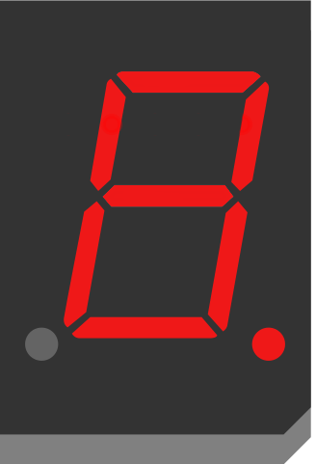
A1
A2
P1
P2
S
P3
T
P4

Slide 10
A1
A2
P1
P2
S
P3
T
P4
TIMER

Slide 11
A1
A2
P1
P2
S
P3
T
P4
TIMER

Slide 12
A1
A2
P1
P2
S
P3
T
P4
TIMER

Slide 13
A1
A2
P1
P2
S
P3
T
P4
TIMER

